Slide 1
Local Control Accountability Plan Committee Meeting
April 23, 2018
Notes:
Good evening!

Slide 2
Agenda
Welcome and Introductions
District budget adjustments and their impact
Annual LCAP monitoring and reporting cycle – How does the District monitor spending and ensure transparency?
Review of Annual Update

Slide 3
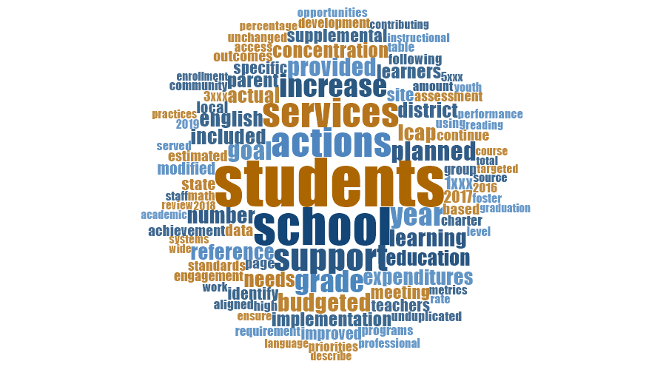

Slide 4
District budget adjustments and their impact
Our 2016-17 ended with a $1.9 million dollar deficit and we are projecting further deficit spending in 2017-18.
Funding from the State is slowing down and we have increased costs from STRS and PERS contributions over the next several years
Notes:
Structural deficit of 1.9 million dollars from fiscal year 2016-17

Slide 5
District budget adjustments and their impact
Our goal is to reduce spending by $5 million over the next three years
How will we accomplish this?
Notes:
Structural deficit of 1.9 million dollars from fiscal year 2016-17

Slide 6
District budget adjustments and their impact
Reduce non-essential expenditures from centralized services
Re-organize central office personnel in a manner to provide similar services
Restructure services so they are provided at the sites
Preserve services and supports for teaching and learning (focus on quality first instruction)
Shift from using external vendors to developing internal capacity
Use a lens of equity when providing site resources vs. a lens of equality

Slide 8
Board Meeting Review – Budget Adjustments
Travel/ Conference
Food at events

Slide 9
Board Meeting Review – Budget Adjustments
This item includes: After school workshops/ summer trainings/ extra duty hours

Slide 10
Board Meeting Review – Budget Adjustments

Slide 11
Annual LCAP monitoring and reporting cycle
How does the District monitor spending and ensure transparency?
Notes:
Data descriptions pop in with a click

Slide 12
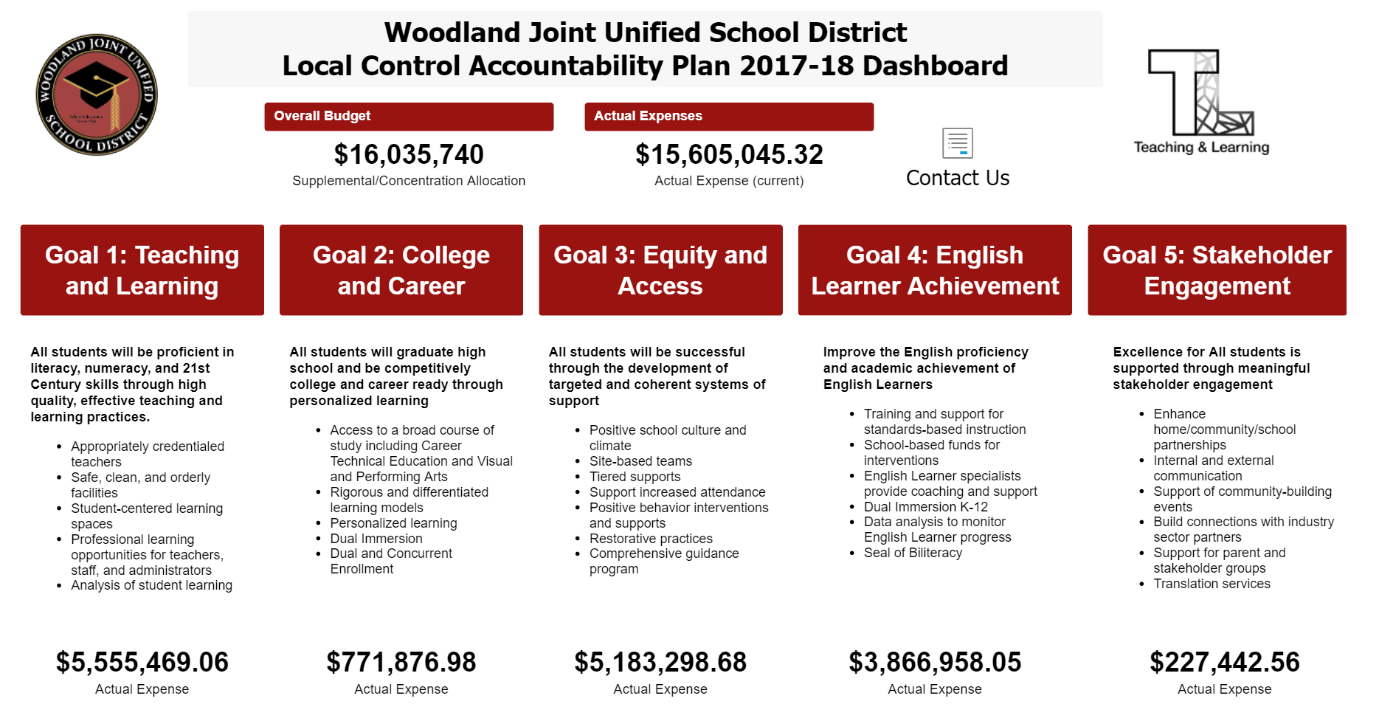
Annual LCAP monitoring and reporting cycle
Notes:
Data descriptions pop in with a click

Slide 13
Review of Draft Annual Update
Notes:
Data descriptions pop in with a click

Slide 14
Highlights of Annual Update
Sections to review:
Summary sections: Greatest Progress (page 2), Greatest Needs (page 3), and Performance Gaps (page 4)
Updates by Goal
Goal 1 – page 6
Goal 2 – page 16
Goal 3 – page 25
Goal 4 – page 36
Goal 5 – page 43

Slide 15
Annual Update: Discussion
What actions and/or metrics are still “under construction” | What actions and/or metrics have shown success?

Slide 16
Questions and Comments

